Slide 1
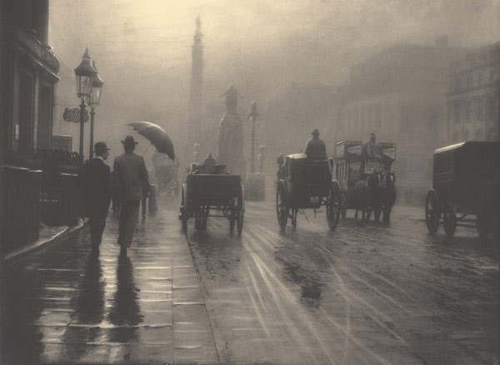
Pictorialism
By: Valerie dingman

Slide 2
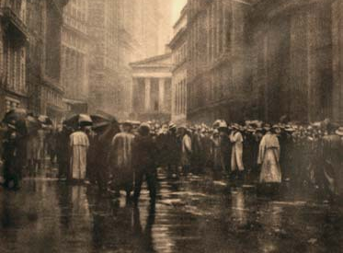
What is Pictorialism?
“An approach to photography that emphasizes beauty of subject matter, tonality, and composition rather than the documentation of reality” -Encyclopedia Britannica
The Curb Market - New York, bromoil print by Joseph Petrocelli, 1920; in the Brooklyn Museum, New York.

Slide 3
Pictorialism started in the late 1800s, when photographers wanted their photographs to be recognized as fine art and not just documentation. Point and shot pictures had increased greatly, due to the fact that Kodak had released their handheld camera in 1888, making it much easier for the average person to go out and take pictures. The increase in travel also made it easier for people to take pictures of things they had not been able to before.
Alfred Stieglitz. The Hand of Man, 1902. Alfred Stieglitz Collection.

Slide 4
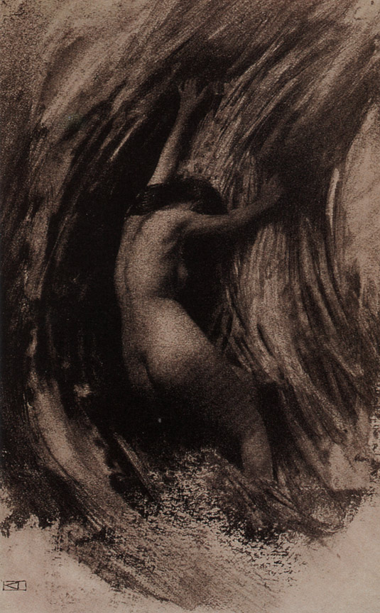
These photographers dismissed the point and shot method and went deep into creating labor intensive techniques, such as hand painting photo paper with home made emulsions and pigments, gum bichromate printing, or platinum prints. Most photographers took up learning how to paint to improve their pictorialism.
Robert Demachy, Struggle, 1904

Slide 5
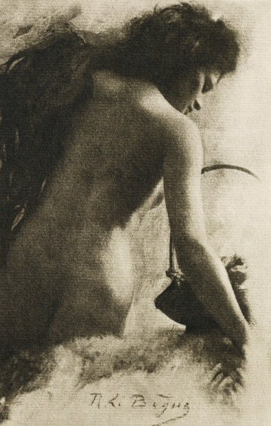
Pictorialism was considered one of the least photography movements. Mostly due to the fact that there was so much painting and manipulation with the photograph itself. Many artists used the doge and burn technique, printing on textured surfaces, and scratching the negatives.
Rene Le Begue, Esquisse

Slide 6
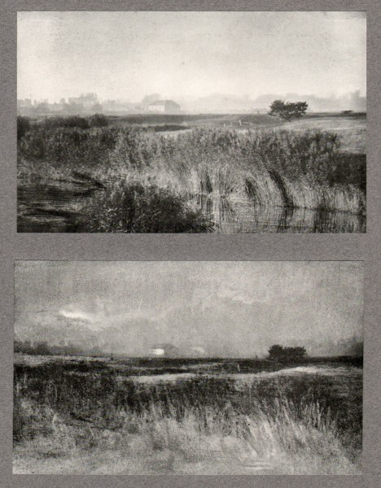
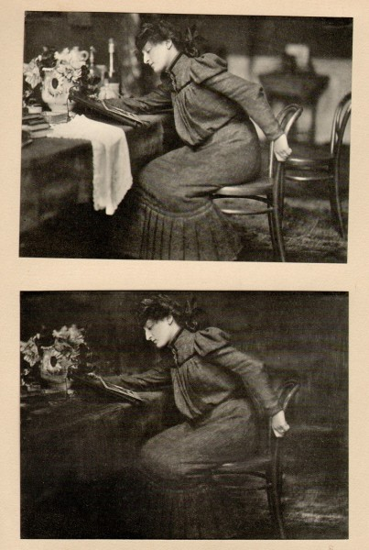
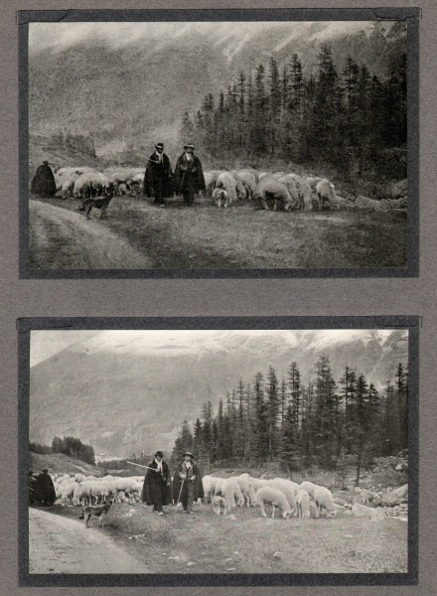
Robert Demachy, La Plaine de Varaville
Robert Demachy, Dans L’Atelier
Constant Puyo, Impression D’Engadine

Slide 7
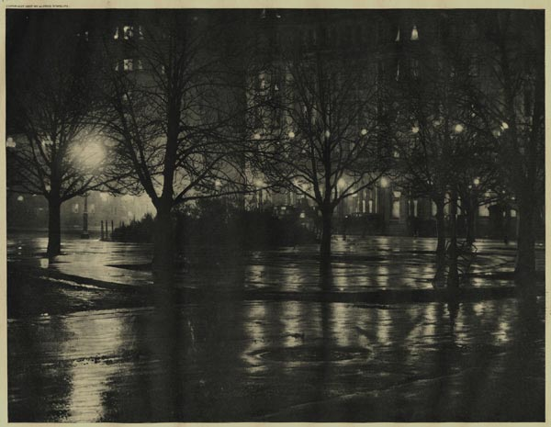
Alfred Stieglitz was one of the most prominent spokes people for establishing pictorialism in America. In 1892 he created a group called the Photo Secession in New York; he handpicked the members of this group that had the same vison as he did with pictorial photography.
Alfred Stieglitz. Reflections, New York, 1896

Slide 8
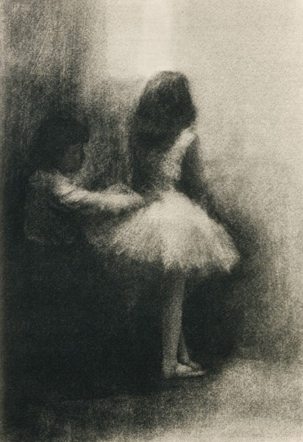
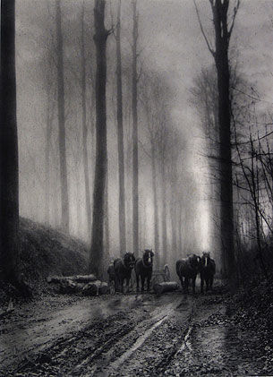
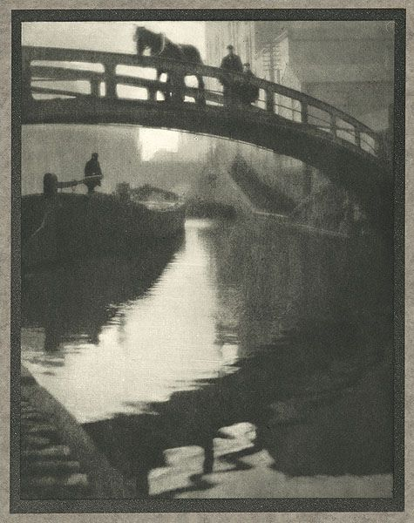
Robert Demachy, L’Habilleuse
Leonard Misonne, Dans La Foret
Alvin Langdon, Regent’s Canal 1910

Slide 9
https://claudiachabo.wordpress.com/2014/05/11/pictorialism/
http://www.britannica.com/topic/Pictorialism
http://www.metmuseum.org/toah/hd/pict/hd_pict.htm
http://www.artic.edu/exhibition/alfred-stieglitz-and-19th-century
http://zgrindlaycop.blogspot.com/2012/03/surrealism.html
http://photoseed.com/collection/group/les-procedes-dart-en-photographie/
https://saroz.wordpress.com/2011/01/21/pictorialism-in-search-of-beauty-for-art/
https://en.wikipedia.org/wiki/Pictorialism
http://www.josephbellows.com/artists/leonard-misonne/#2
https://www.flickr.com/photos/photo-tractatus/4797482808/in/faves-f_munch/

